Slide 1
Graph Convolutional Neural Networks for 3D Point Cloud Classification: The PointGCN1 Model and Beyond
Mohamd choupan

Slide 2
Outline
01
Introduction
04
Graph Pooling
What is problem ?
02
Graph Signal Processing and Graph Convolution
Experimental Results and Comparison
05
03
Graph-CNN Architecture for 3D Point Cloud Classification
Conclusion
06

Slide 3
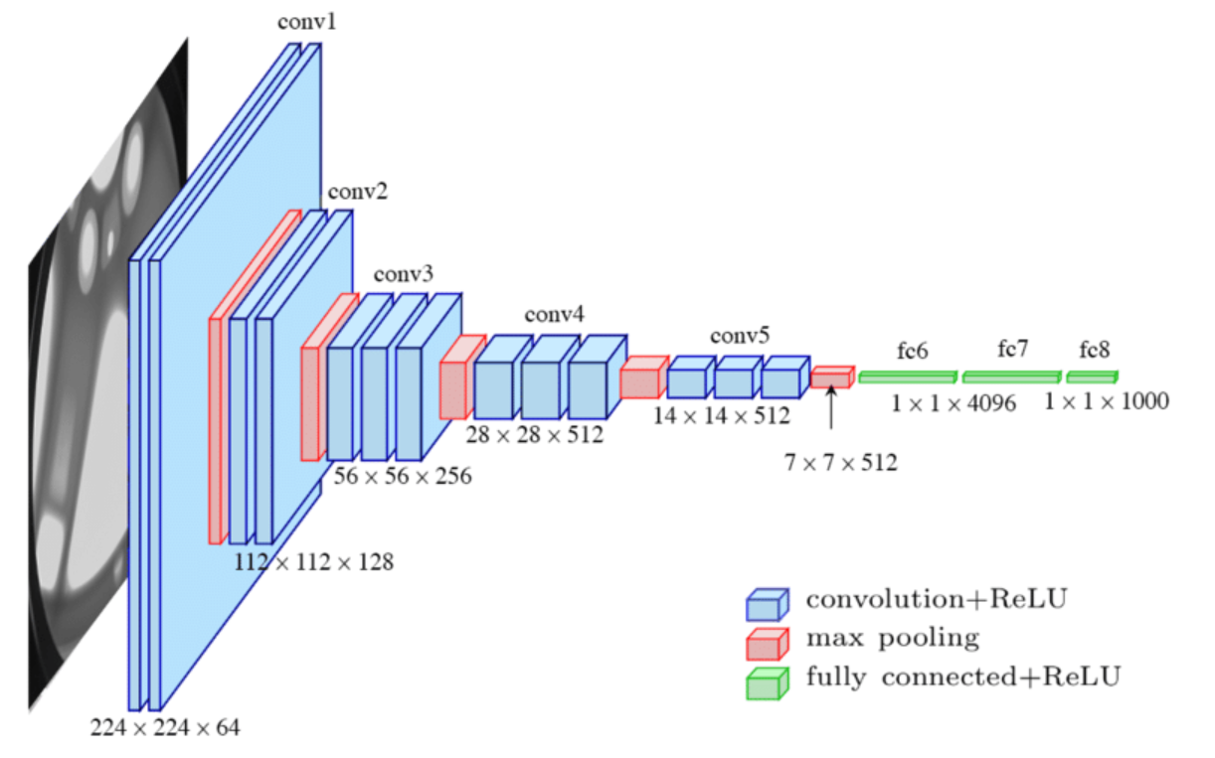
Introduction
Background on graph convolutional neural networks (Graph-CNNs)
Motivation for using Graph-CNNs for 3D point cloud classification
Overview of the PointGCN1 model

Slide 4
Graph Signal Processing and Graph Convolution
Introduction to graph signal processing
Laplacian
Challenges
unstructured and a graph is imposed to capture the manifold
structure
Challenges of applying convolution on graphs
Previous work on graph convolutional neural networks
Point net
Fast localized convolution operation proposed
Chebyshev polynomials

Slide 5
Graph-CNN Architecture for 3D Point Cloud Classification
01
02
Problem statement and dataset description
Classified Point cloud

Slide 6
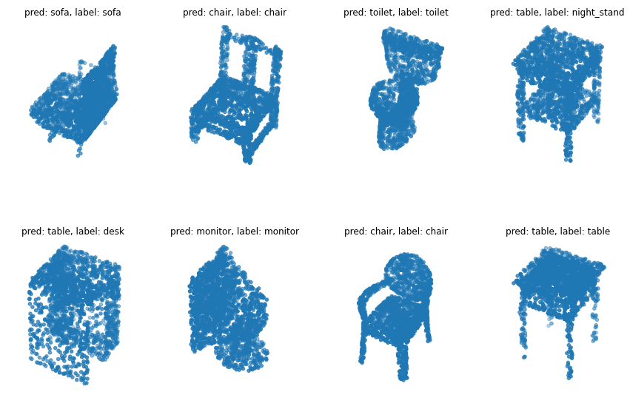
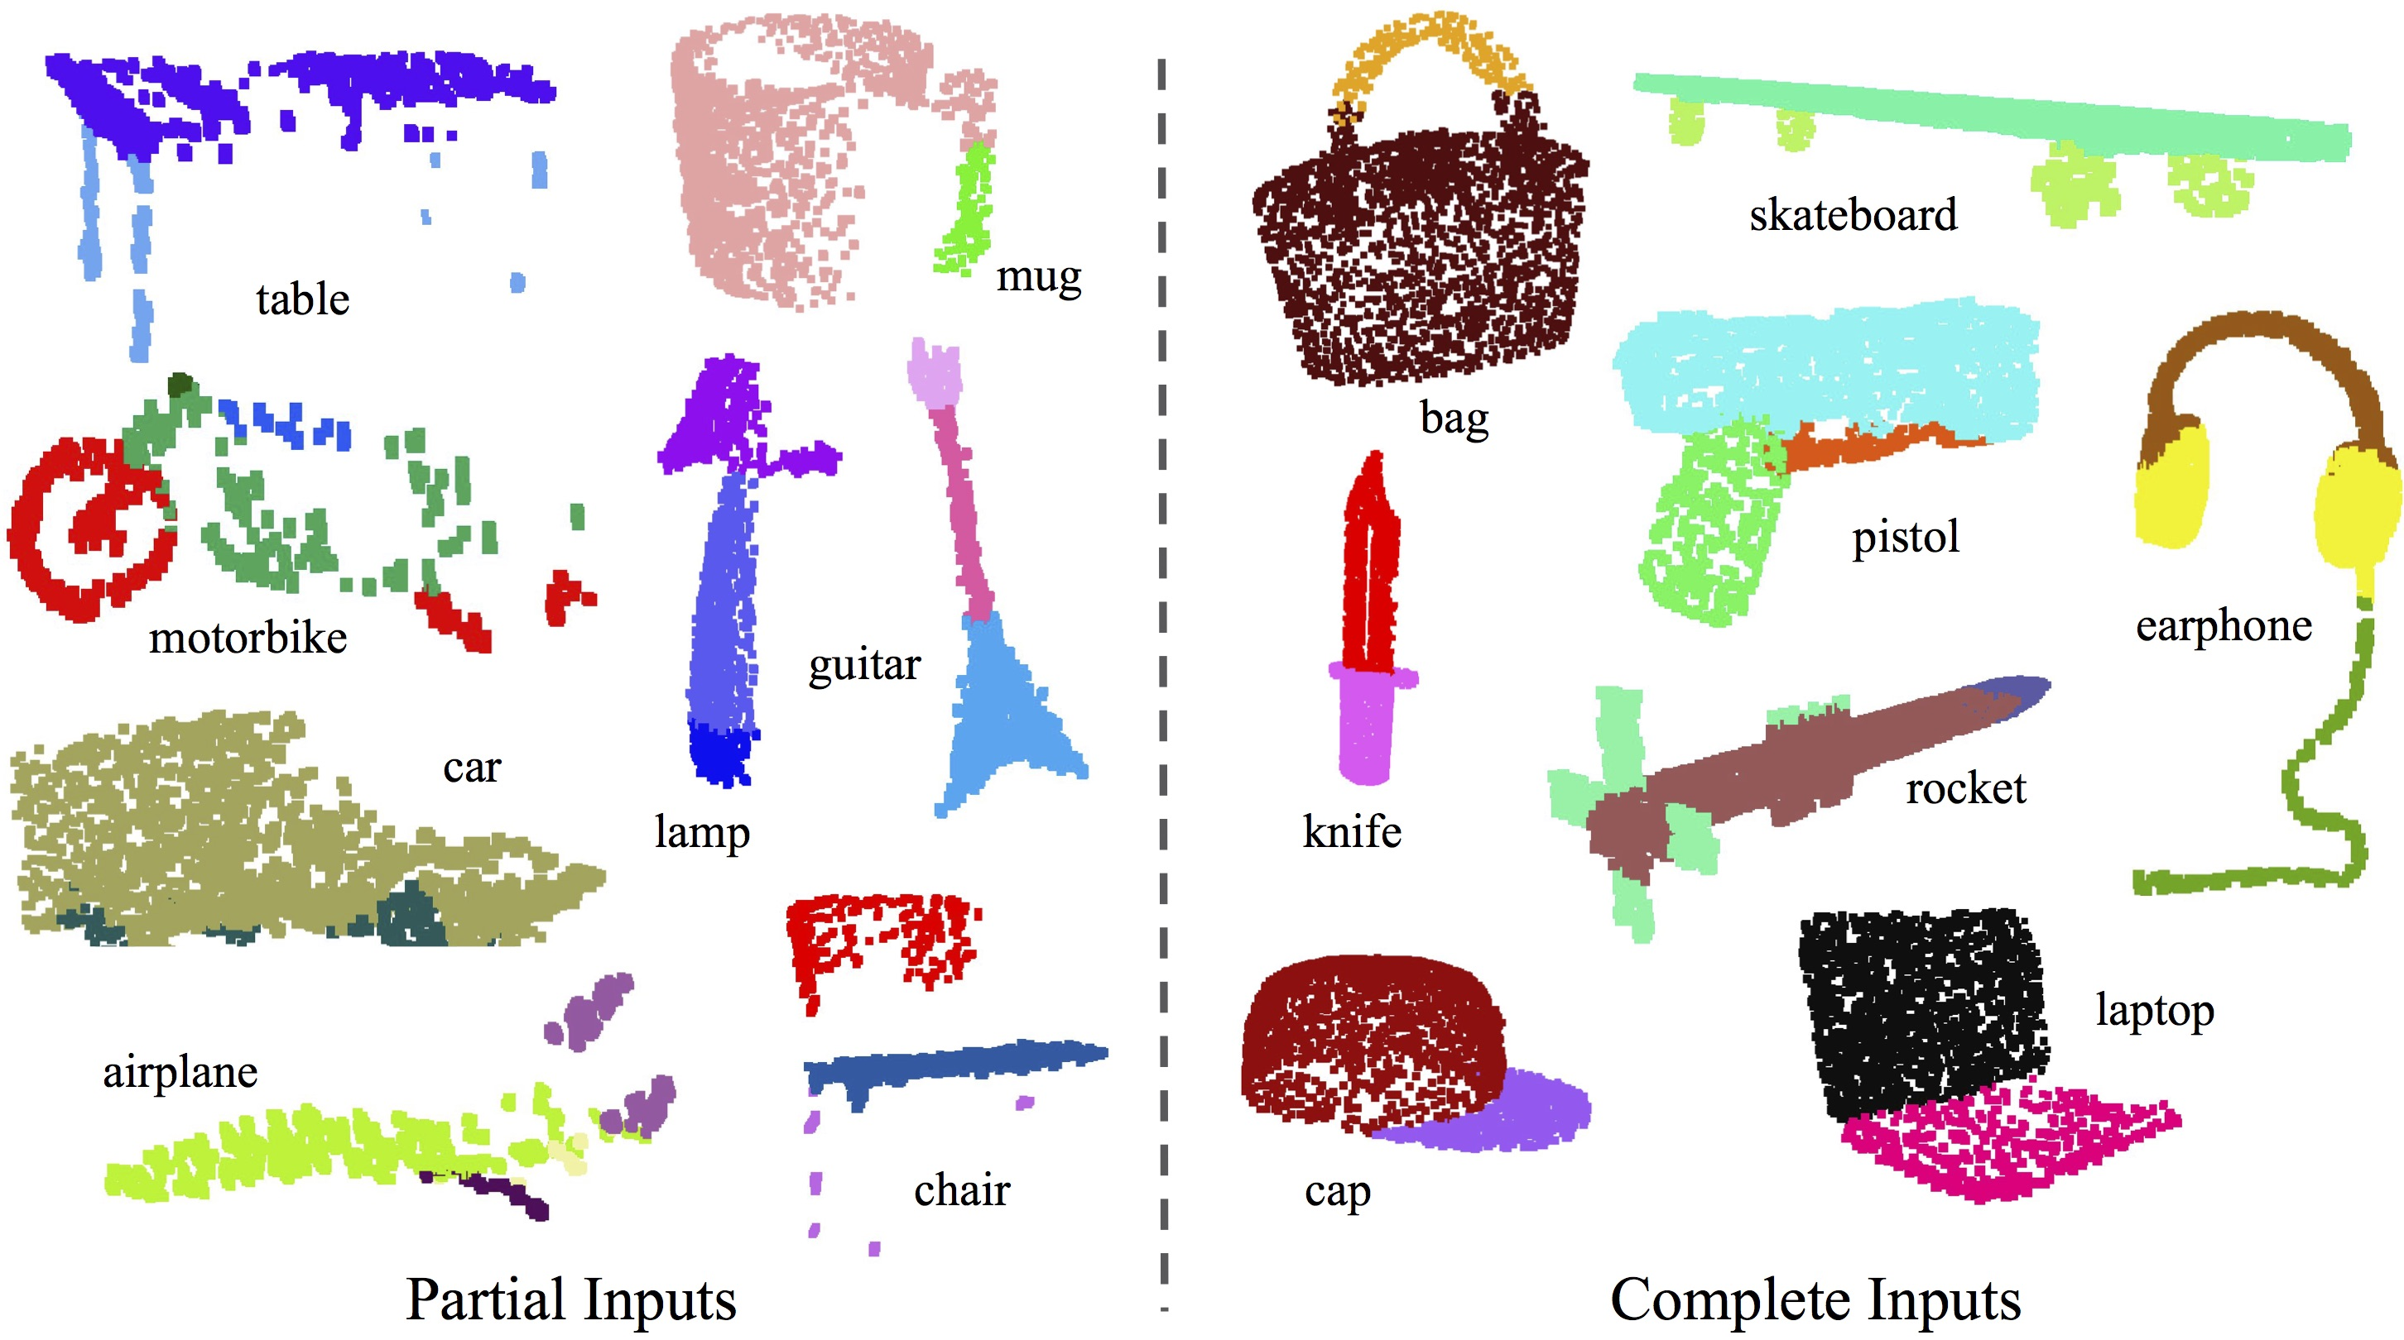
Problem statement and dataset description
Model Net

Slide 7
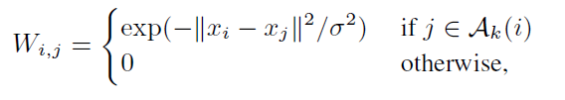
Methodology
KNN
Gaussian kernel

Slide 8



Graph Signal Processing
Laplacian matrix
Chebyshev polynomals

Slide 9
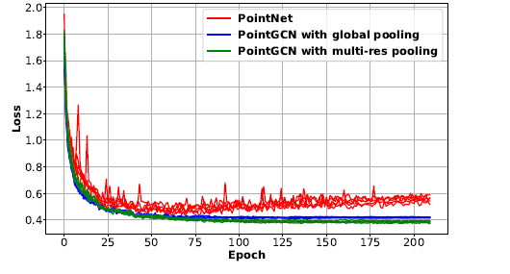
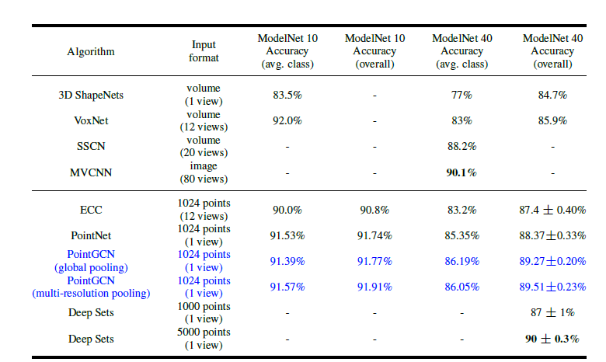
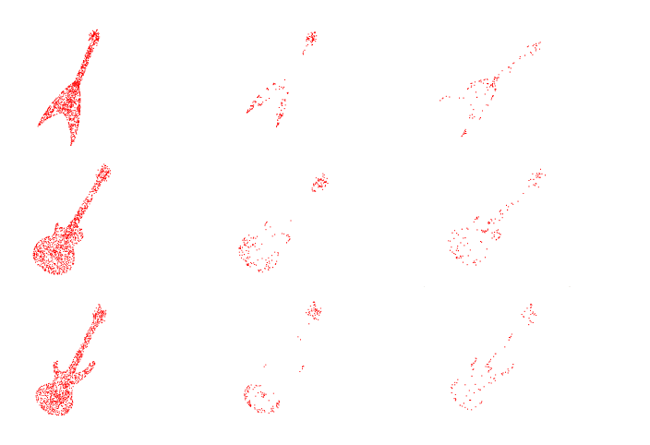
Results

Slide 10
Conclusion
positive feature
drawbacks

Slide 11
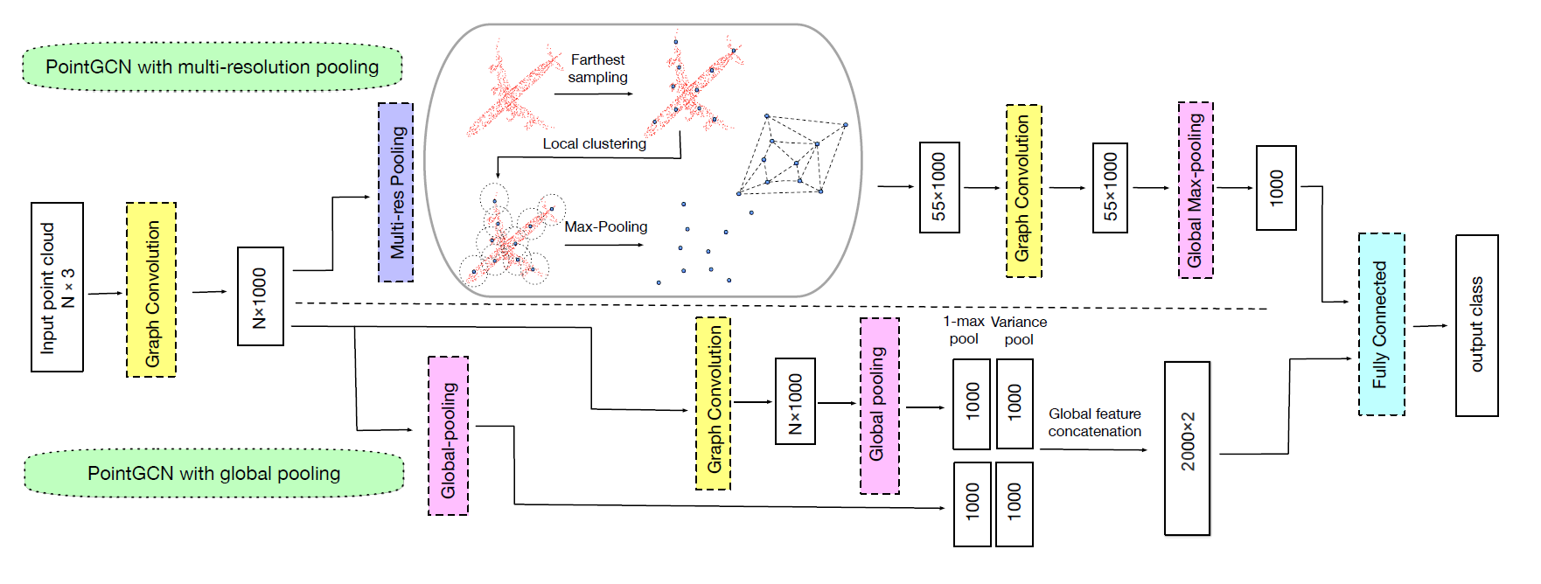
Graph-CNN Architecture

